Slide 1

DSC530 Final Project
Cody Myers
Bellevue University
Summer 2020

Slide 2
Question
For this project, I am looking to take a deeper dive into the NSFG pregnancy data set. I would like to see if there is a relationship between a respondents socio-economic status, the outcomes of their pregnancies, and the number of times the respondents becomes pregnant.

Slide 3
Variables
The variables chosen below are based on answering some questions I have regarding the NSFG data. I felt that we didn’t tap into wealth of data that this data source had to offer. I wanted to look at how much a person’s social life and upbringing had to do with the number of times someone became pregnant.
caseid | poverty
religion | educat
pregoutcome | pregnum

Slide 4
Variables (cont.d) - Reasoning behind each variable
Caseid
To be used for identifying unique records in the data set.
Poverty
This will be used to understand the economic status of those involved in the study.
Religion
Determines the religious affiliation of the respondent (if any).
Educat
Number of years the respondent has had of formal education.
Prgoutcome
The success or failure of a pregnancy.
Pregnum
The number of times the respondent has been pregnant.

Slide 5
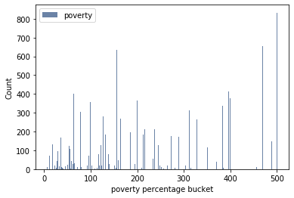
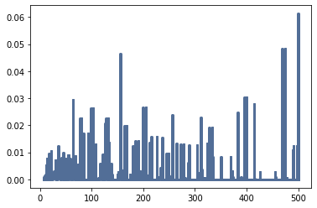
Poverty Variable Histogram and PMF plot

Slide 6
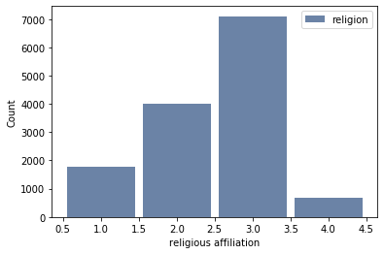
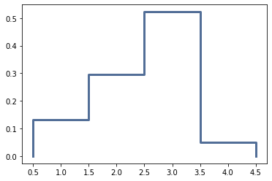
Religion Variable Histogram and PMF plot

Slide 7
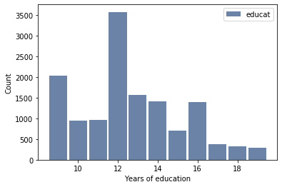
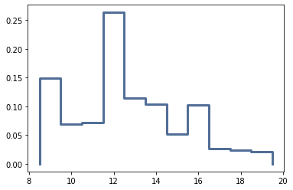
Education Variable Histogram and PMF plot

Slide 8
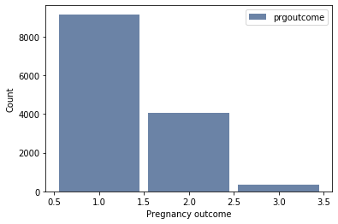
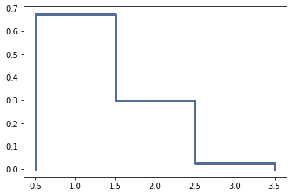
Pregoutcome Variable Histogram and PMF plot

Slide 9
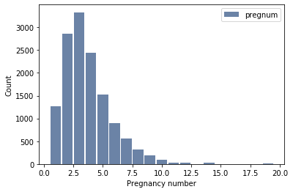
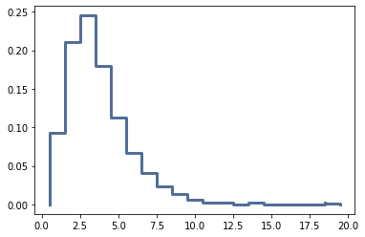
Pregnum Variable Histogram and PMF plot

Slide 10
Statistical Summary
 | poverty | religion | educat | prgoutcome | pregnum
mean | 219.226146 | 2.491062 | 12.664680 | 1.351088 | 3.698301
min | 7.000000 | 1.000000 | 9.000000 | 1.000000 | 1.000000
max | 500.000000 | 4.000000 | 19.000000 | 3.000000 | 19.000000
median | 180.000000 | 3.000000 | 12.000000 | 1.000000 | 3.000000
skew | 0.524108 | -0.480107 | 0.424114 | 1.141946 | 1.617534

Slide 11
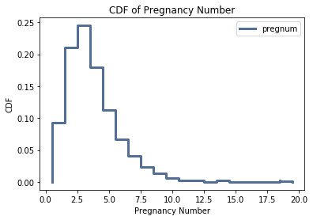
CDF and understanding
By looking at our CDF plot on the right, we can tell that about 90% of the respondents have had less than 10 pregnancies at the time of the response. Most of that 90% has had less than 5 pregnancies.

Slide 12
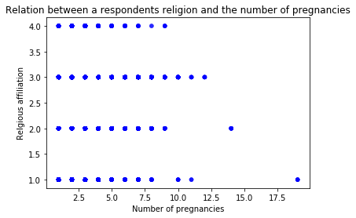
Scatterplots – Religion v Pregnancy number
Upon looking at the distribution of this plot, it doesn’t seem like there is much of a correlation between a respondents religious views and the number of pregnancies they have.
1 | No Religion
2 | Catholic
3 | Other

Slide 13
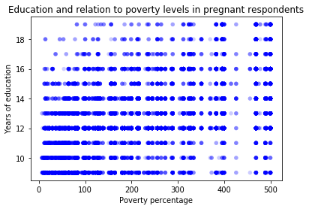
Scatterplots (pt 2)
By looking at the scatterplot here, we see that there is a connection between one’s number of years in education and the percentage above or at poverty that the respondent currently brings in every year. We can also say that the relationship between the two variables is a positive one, but there is a disconnect at the upper bounds of the poverty percentage. It seems as though there is an almost even distribution between years of education and wealth at the highest end of the wealth boundary.

Slide 14
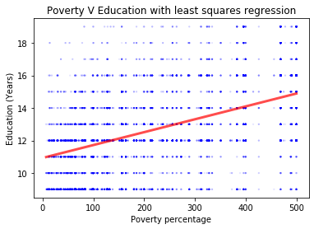
Hypothesis and regression
From our plot to the right, one can deduce that my hypothesis is correct. We see that the best fit curve is a straight line with a positive relationship between the two variables.
We can note though that as I predicted, there is not a strong positive relationship. From the best fit line alone, it is not a clear indicator to say if there is an even distribution of wealth based upon one’s investment in their education.
One aspect of this distribution that we can see is that there is a correlation between having an extreme number of years of formal education (16+) and not having a yearly income in the bottom 25% of respondents.

